Slide 1
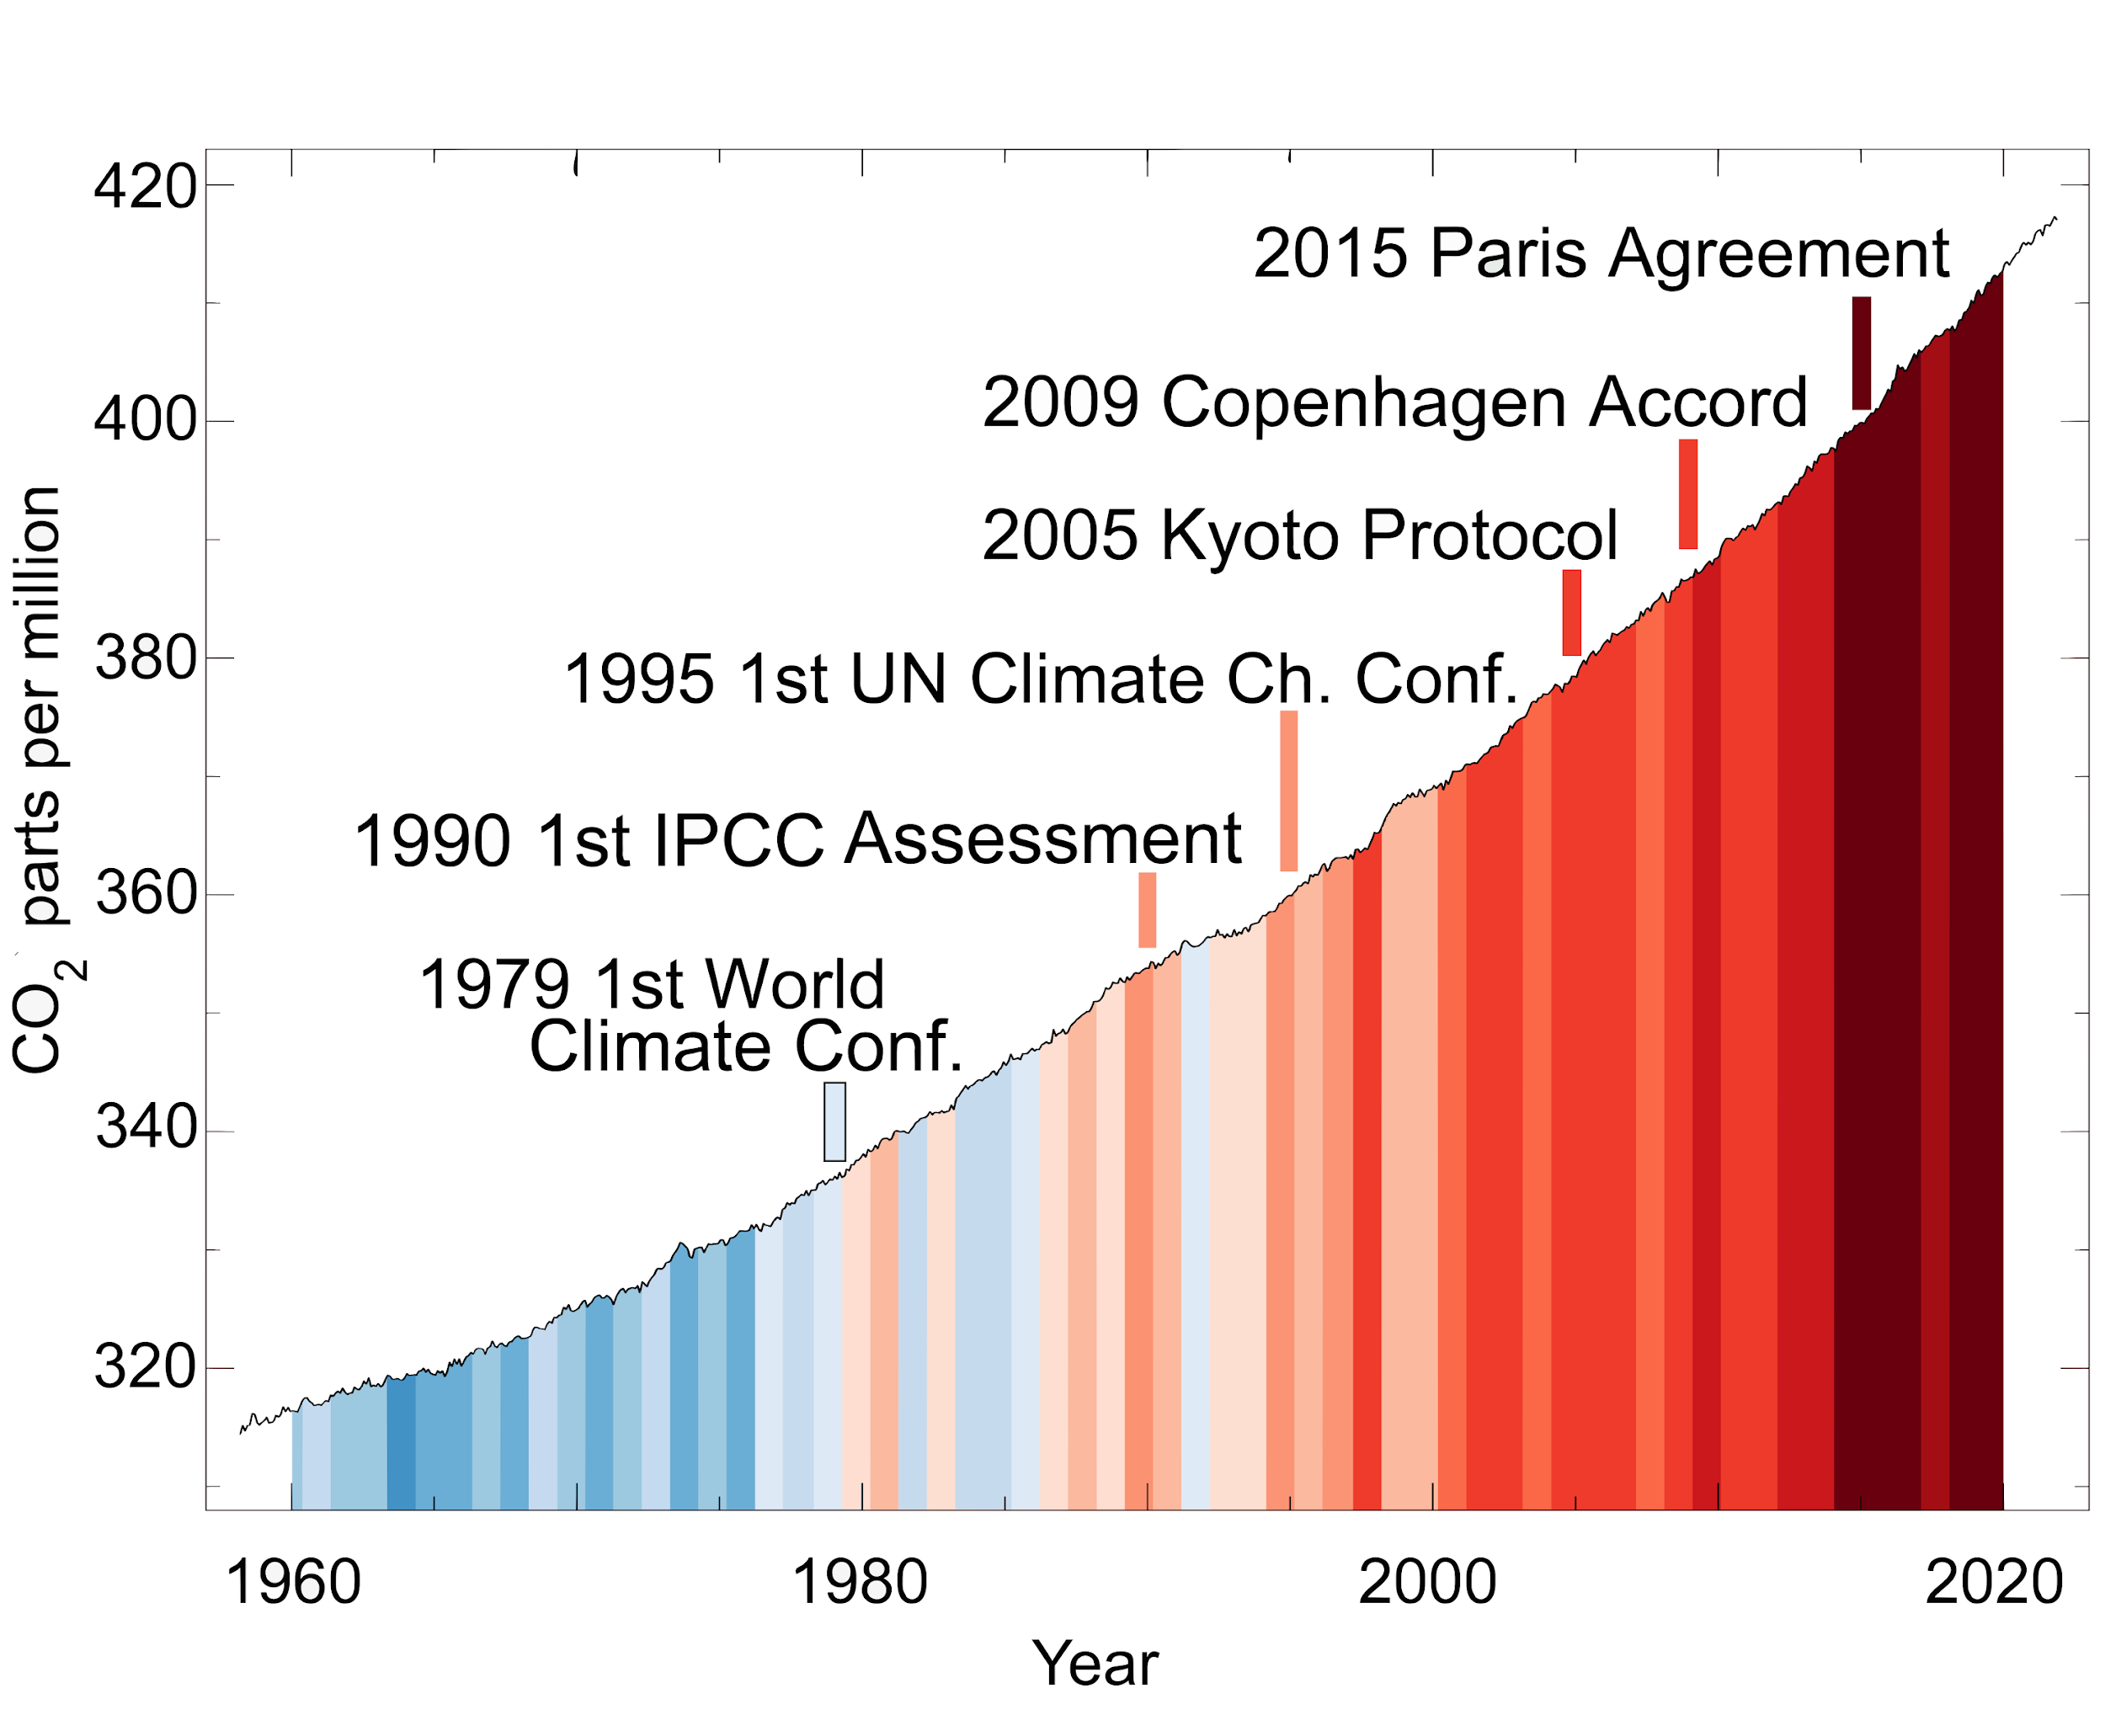
From Wikimedia Commons
Attribution/reference:
@MuellerTadzio, @wiebkemarie, @MariusHasenheit, @sustentioEU
CO₂ and global temperatures rise despite promises

Slide 2
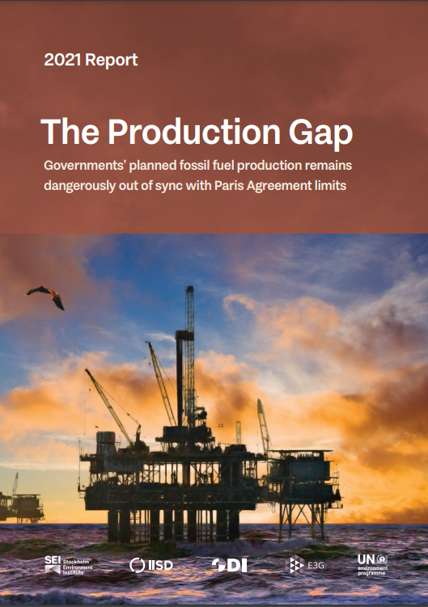
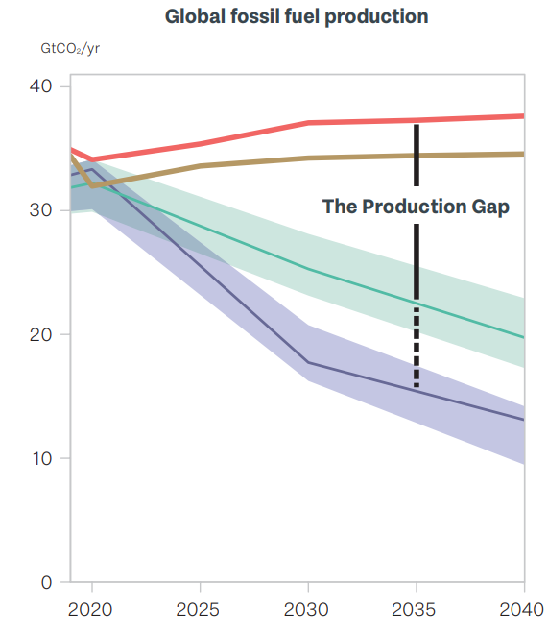
Production exceeds promised reduction
Countries’ plans & projections
Production implied by climate pledges
Production consistent with 2°C
Gigatonnes of CO₂ per year
Production consistent with 1.5°C
1 Gigatonne = 1,000,000,000 tonnes
Year
Scan for more info

Slide 3
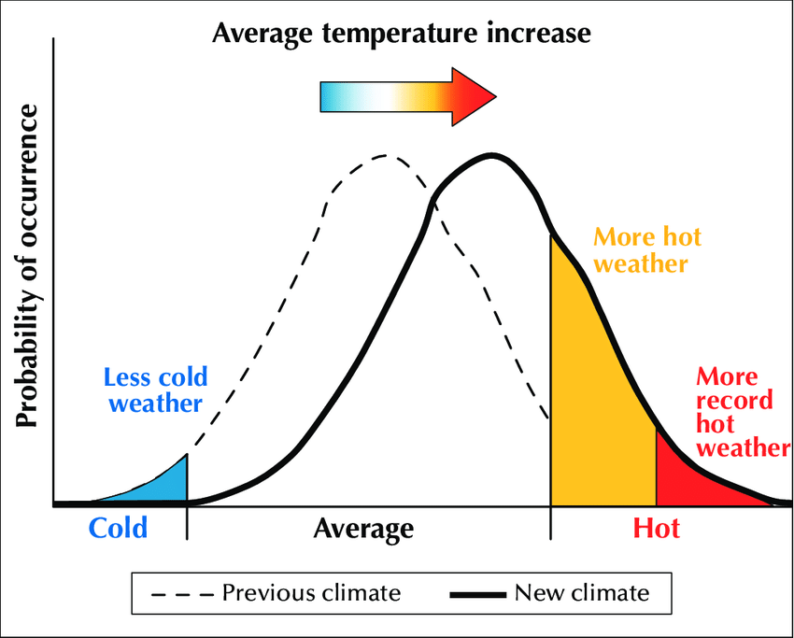
Higher average temperatures make extreme hot weather more likely
Heat waves pose a major risk to public health
“In an average year in the US, heat kills more people than any other type of extreme weather” Kristina Dahl, Senior Climate Scientist
Scan for explanation of models

Slide 4
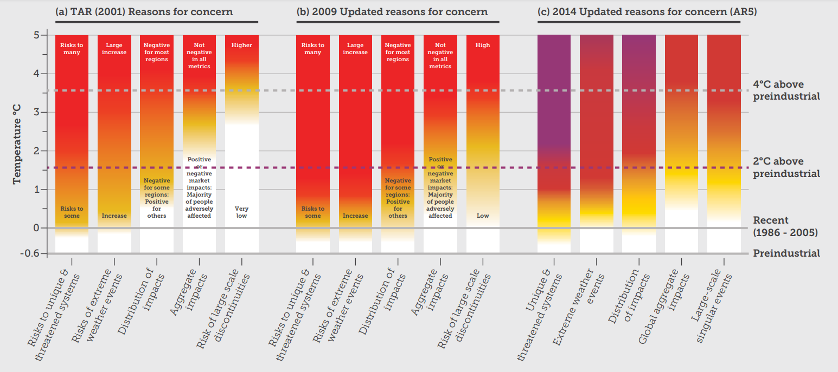
Overall risks and impacts turn to high, faster than anticipated
Scan for more info
Unique and threatened systems | Risks to ecological and human systems, such as coral reefs, the Arctic and its Indigenous People, mountain glaciers and biodiversity hotspots.
Extreme weather events | Impacts to human health, livelihoods, assets and ecosystems from extreme weather events such as heatwaves, heavy rain, drought and associated wildfires, and coastal flooding.
Distribution of impacts | Aggregated risks/impacts that disproportionately affect particular groups, such as vulnerable societies and socio-ecological systems, including disadvantaged people and communities in countries at all levels of development, due to uneven distribution of physical climate change hazards, exposure or vulnerability.
Global aggregate impacts | Impacts to socio-ecological systems that can be aggregated globally into a single metric, such as monetary damages, lives affected, species lost or ecosystem degradation at a global scale.
Large-scale singular events | Relatively large, abrupt and sometimes irreversible changes in systems caused by global warming, such as ice sheet disintegration or thermohaline circulation slowing and sometimes called tipping points or critical thresholds.
Notes:
a904b54ce67740c4b4ee2753134154b0.pdf

Slide 5
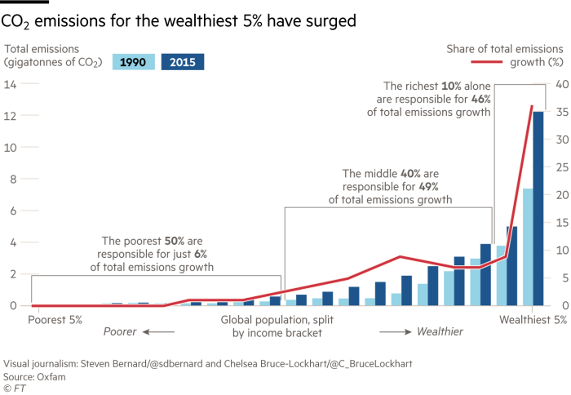
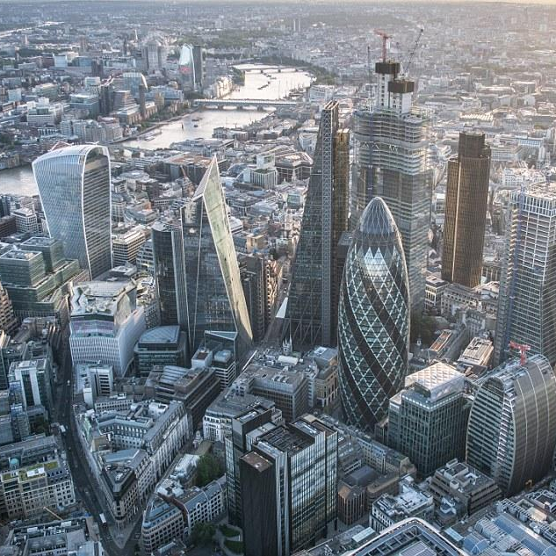
Consumption of richest 10% accounts for almost half of CO₂ emissions
Who are the rich?
Richest 10%
Annual income of £27,500
Richest 1%
Annual income of £79,000
Source: Oxfam/Stockholm Environment Institute
Scan for more info
The City of London remains one of the largest global centres for financing fossil fuels, supporting at minimum 15% of potential global CO₂ emissions
Source: Carbon Tracker 2020
← Scan for report

Slide 6
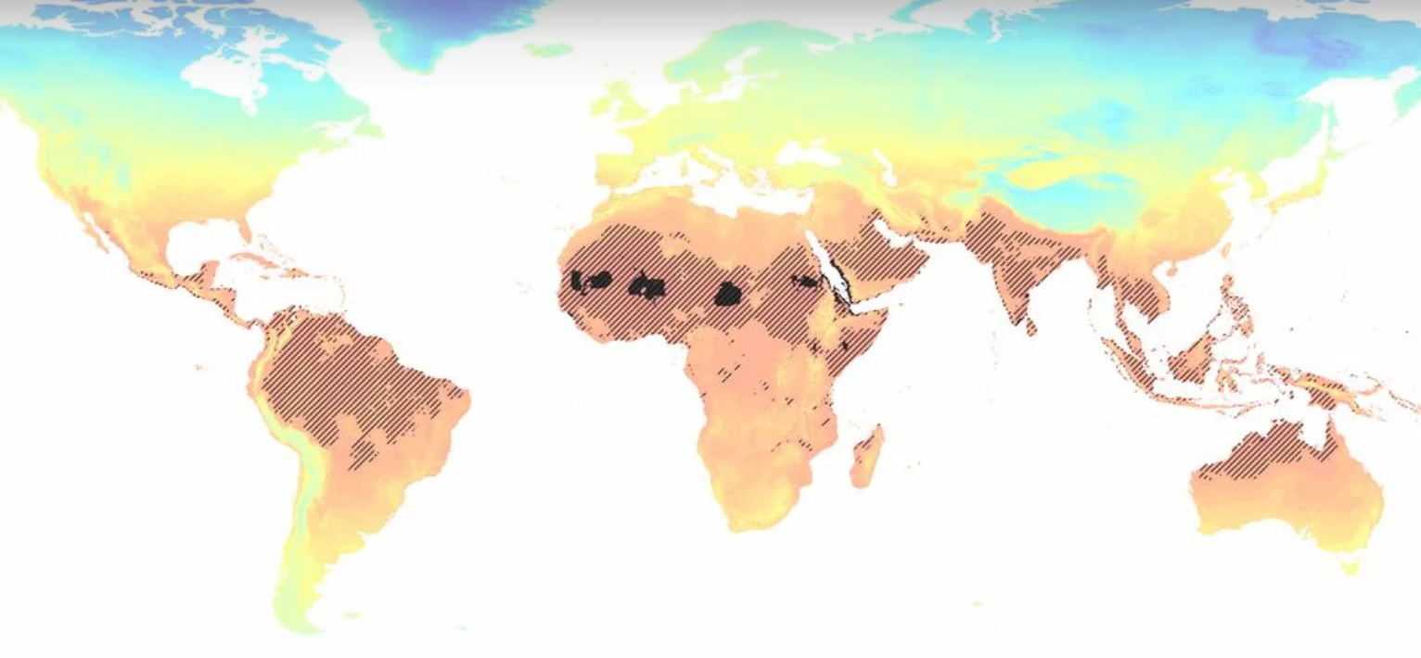
1 billion people displaced for every additional 1°C of global warming
Today
0.8% of land surface too hot for human existence
3°C
19% of land surface too hot for human existence
Source: international research collaboration published in The Proceedings of the National Academy of Sciences
← Scan for article

Slide 7
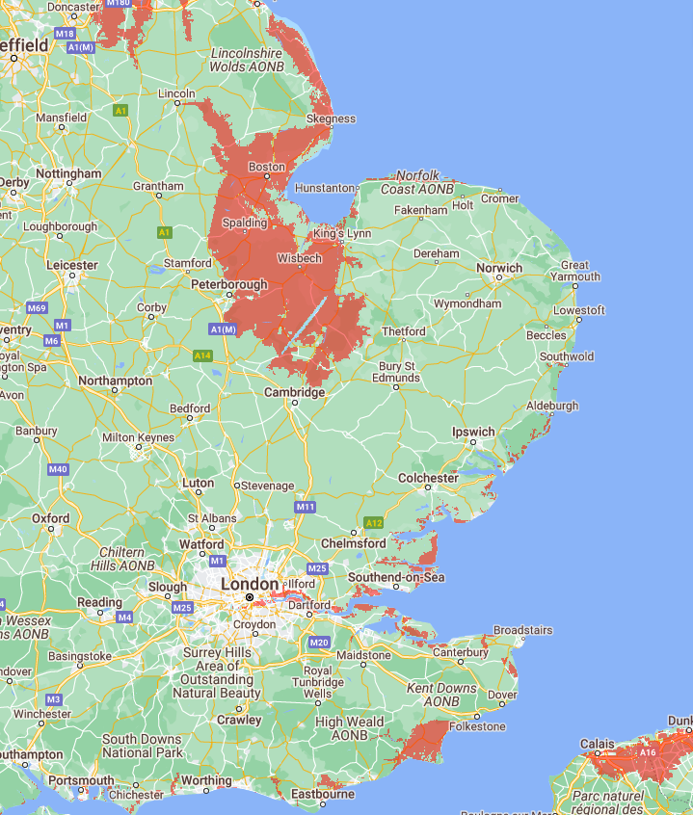
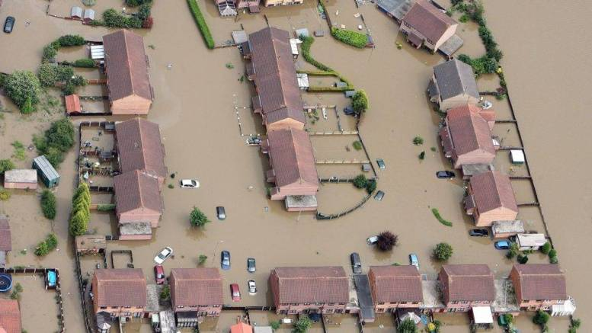
Parts of the UK under water by 2050
NASA predicts sea level to rise up to a foot by 2050
Water level of 1.0 feet above the high tide line could be reached through combinations of sea level rise, tides, and storm surge. Areas will face a choice either will need to be abandoned or upgrade their defences.
©Hull City Council
Below water level with just 30 cm (1 foot) sea rise
Almost half of London’s commercial buildings are at risk from floods fueled by the climate crisis
Scan for more info
Maps from coastal.climatecentral.org
Notes:
Sea Level to Rise up to a Foot by 2050
https://www.nasa.gov/feature/jpl/sea-level-to-rise-up-to-a-foot-by-2050-interagency-report-finds
Maps from https://coastal.climatecentral.org/
Feb 2022 - University of Cambridge research -
First concrete evidence of an ice-sheet mass-loss mechanism, which is not yet included in projections of global sea level rise
https://phys.org/news/2022-02-greenland-ice-sheet-world-largest.html
https://www.edie.net/news/9/Almost-half-of-London-s-commercial-properties-exposed-to-higher-flood-risks/

Slide 8
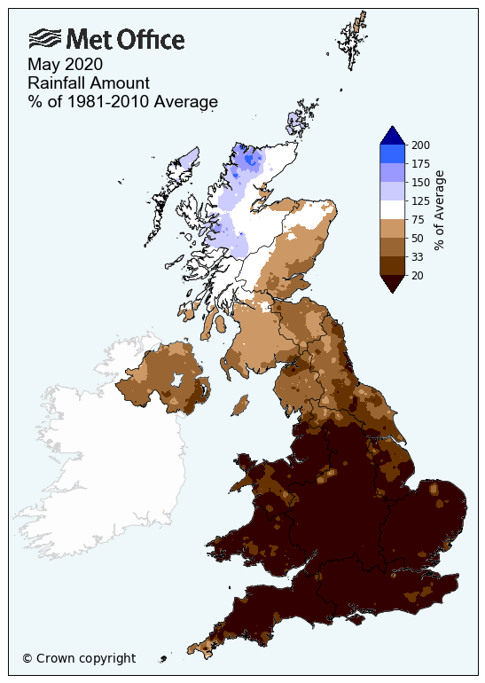
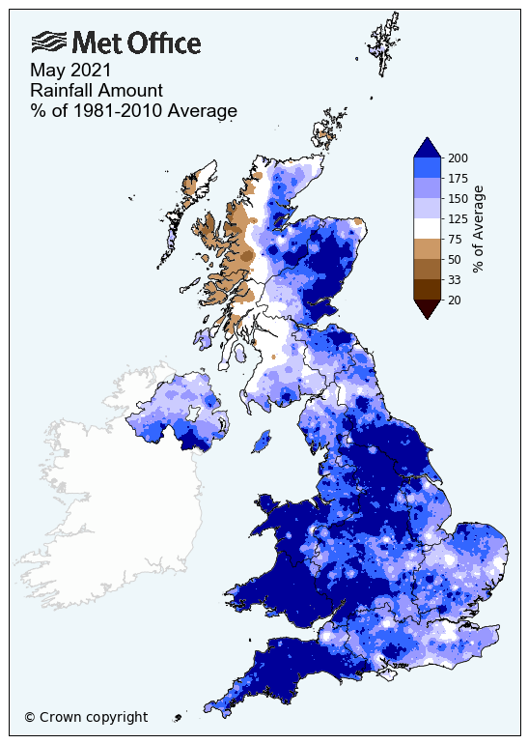
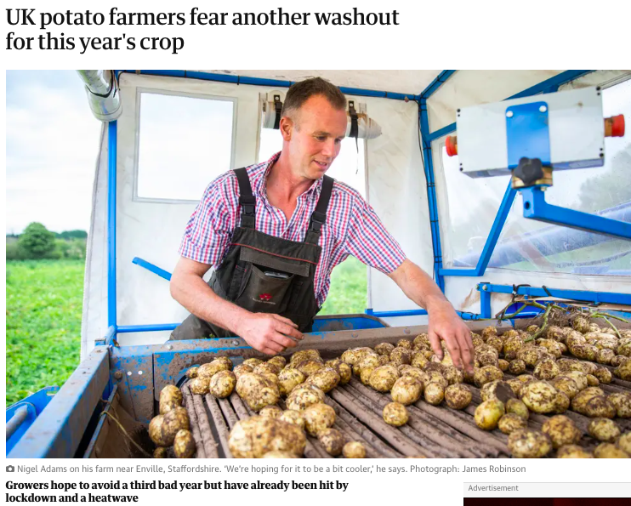
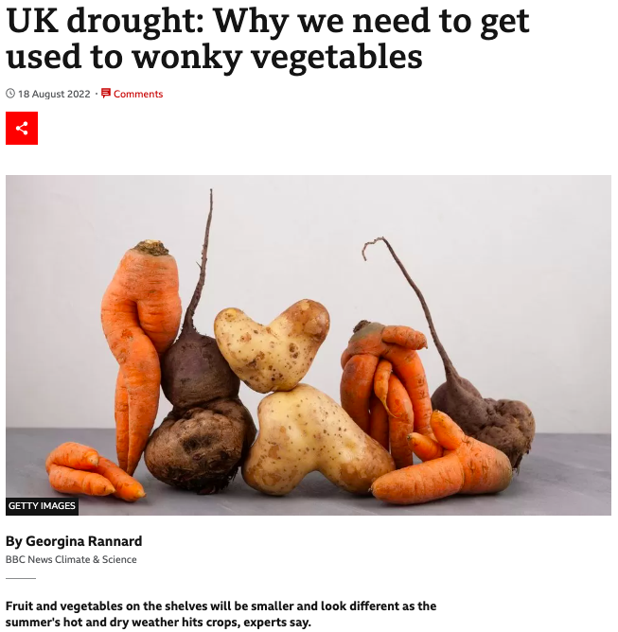
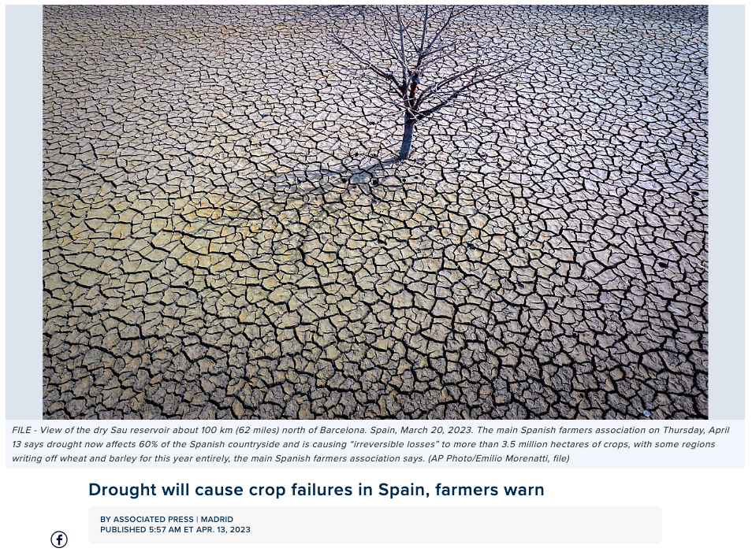
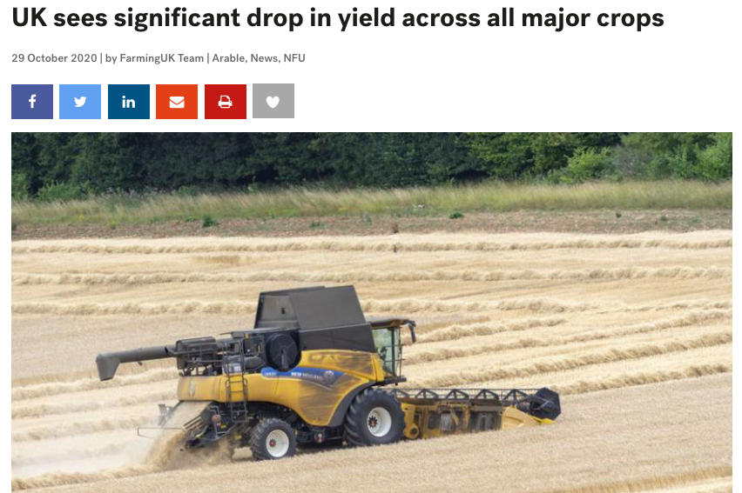
Unpredictable weather = unpredictable food supply
May 2020 becomes the sunniest calendar month on record
May 2021 Wales’ wettest in 160 years
Scan for Met Office climate impacts research

Slide 9
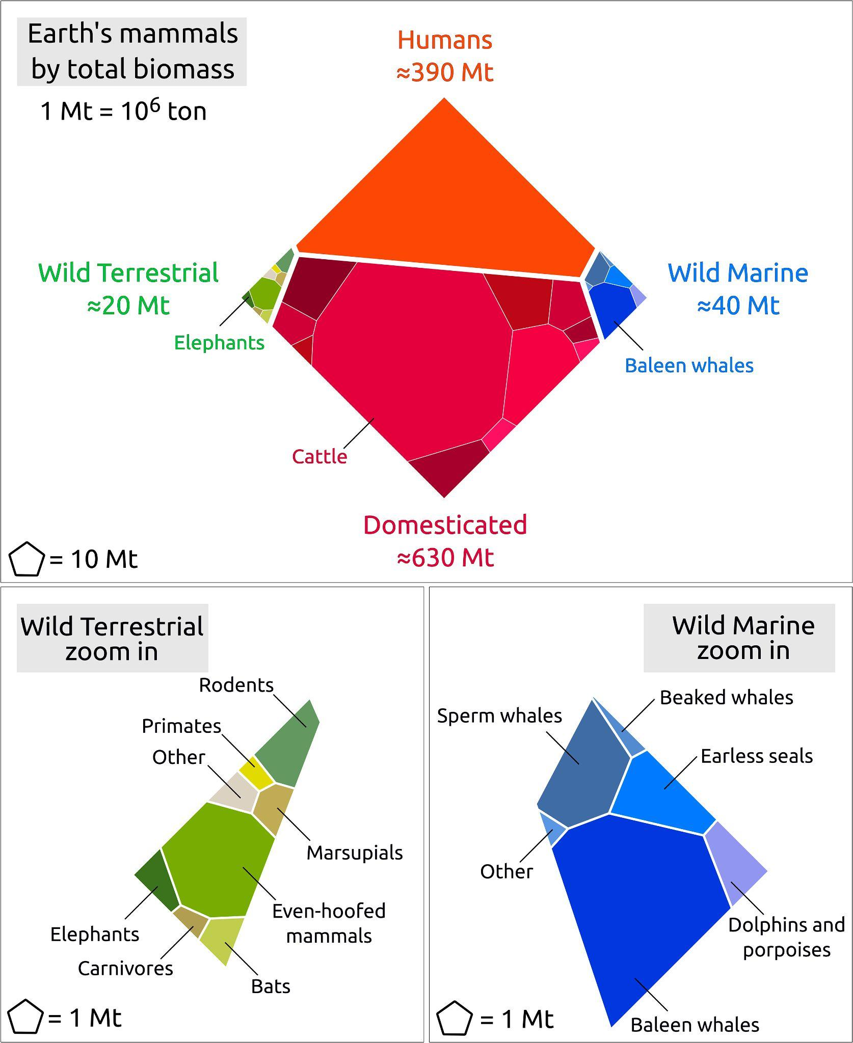
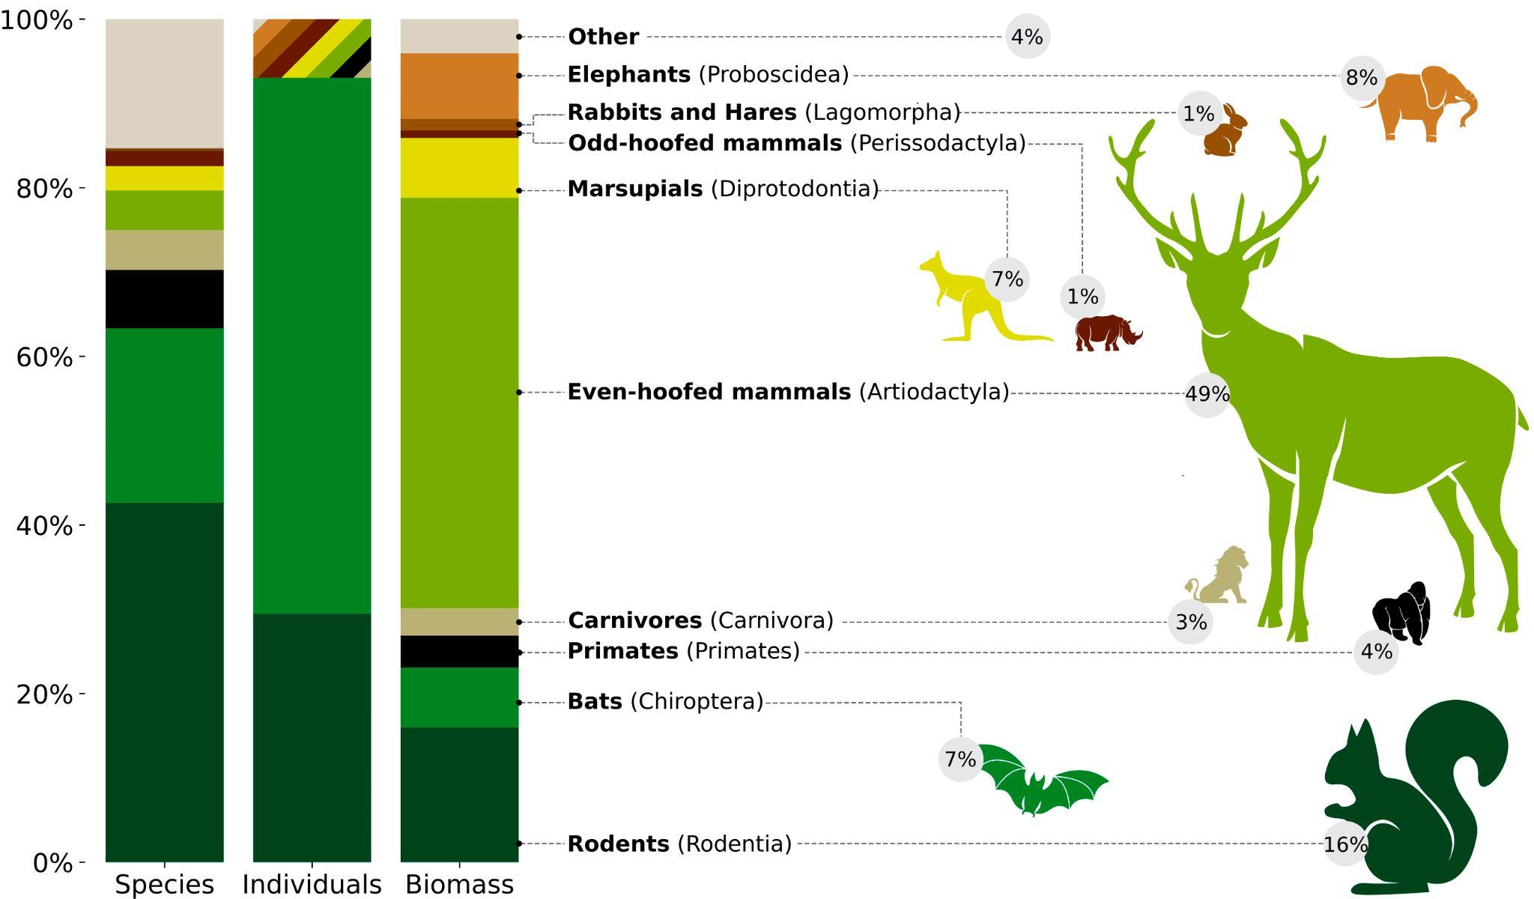
Domestic species compete with wild mammals for Earth’s resources
Source: Research published in The Proceedings of the National Academy of Sciences
Scan for article →

Slide 10
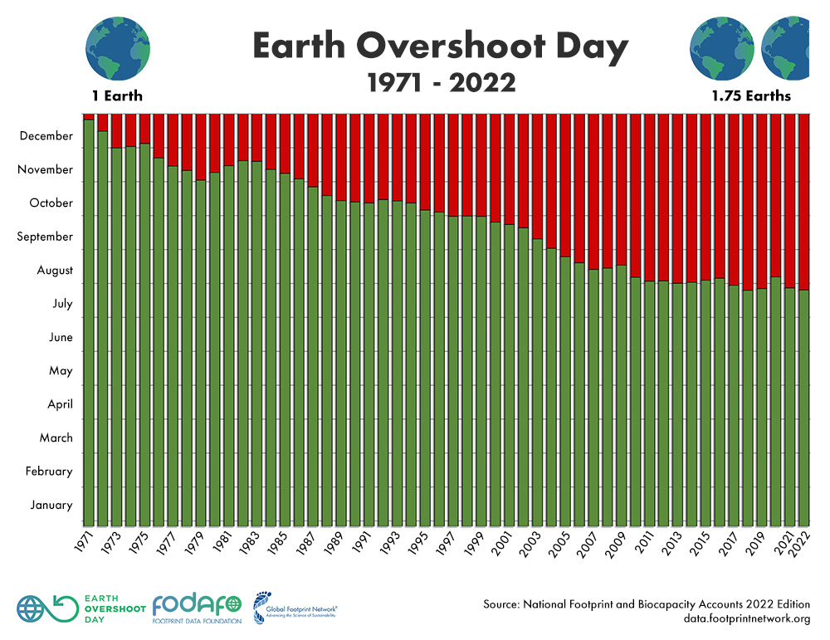
We are depleting our resources and Earth’s capacity to regenerate at an alarming rate
How many Earths would we need if everyone lived like UK residents?
How many Earths does the UK need to meet its residents’ demand on nature?
Scan for more info

Slide 11
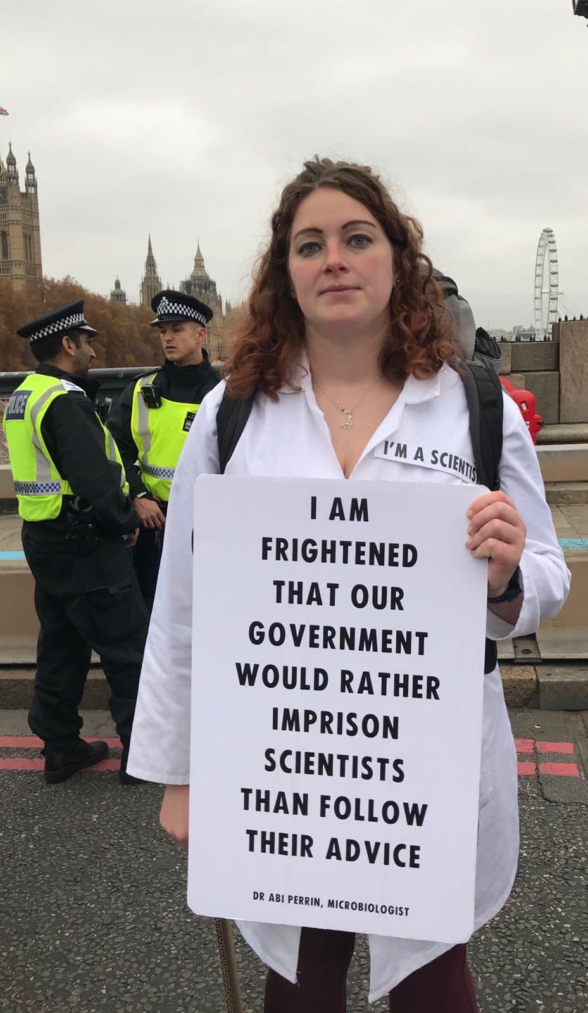
Scan to find out more

