Slide 1
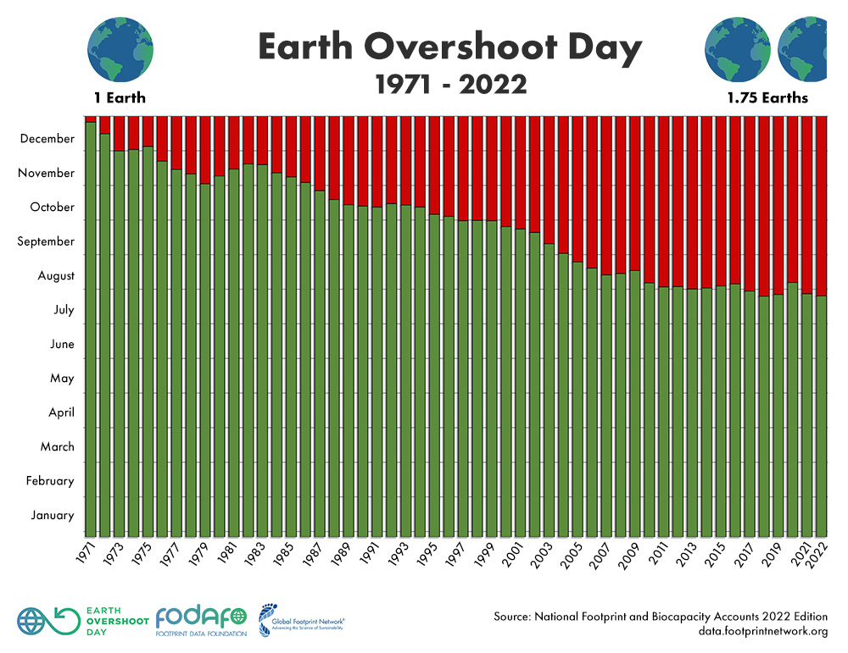
We are depleting our resources and Earth’s capacity to regenerate at an alarming rate
How many Earths would we need if everyone lived like UK residents?
How many Earths does the UK need to meet its residents’ demand on nature?
Scan for more info

