Slide 1
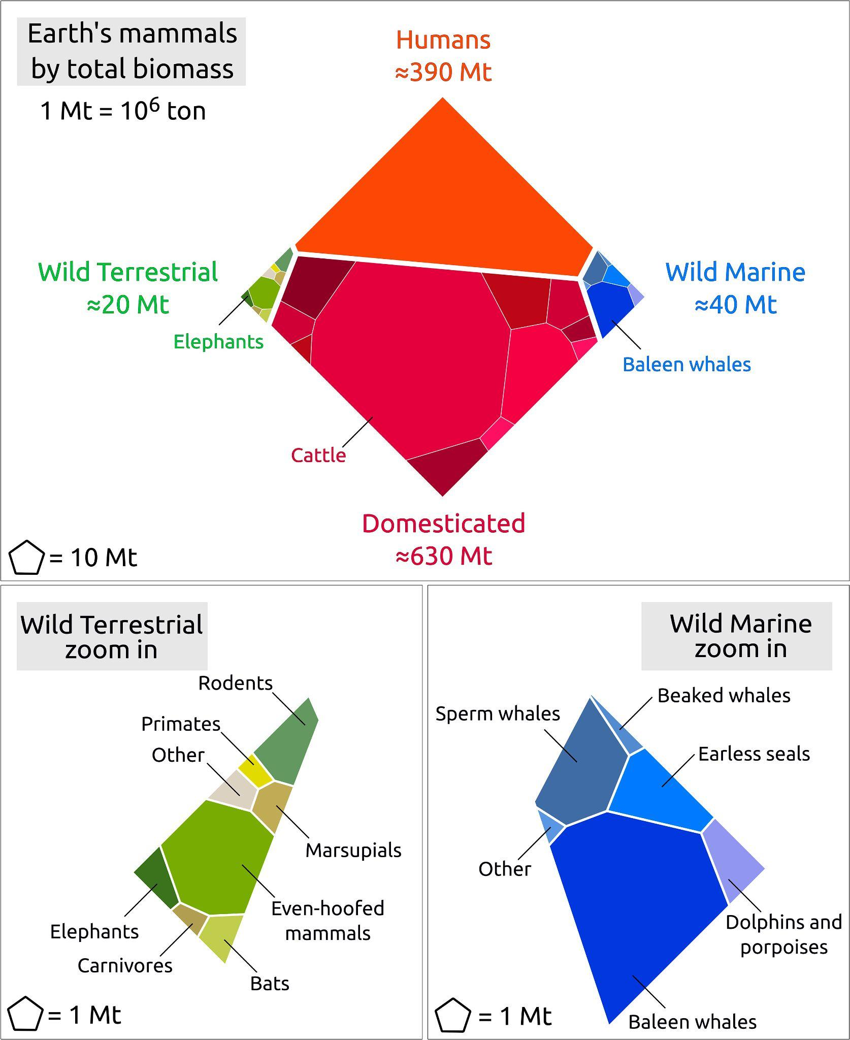
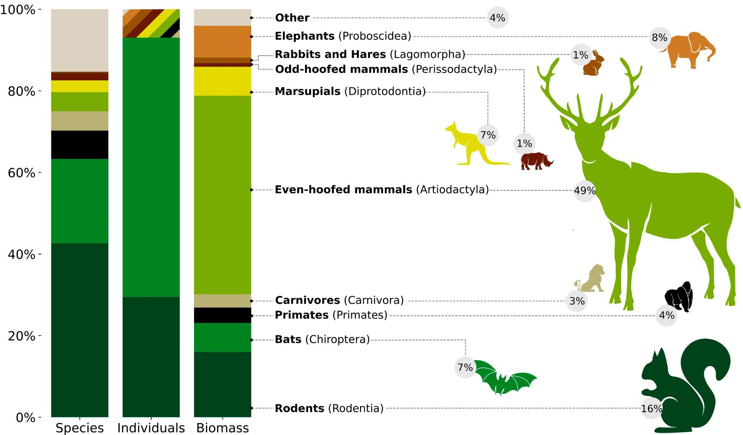
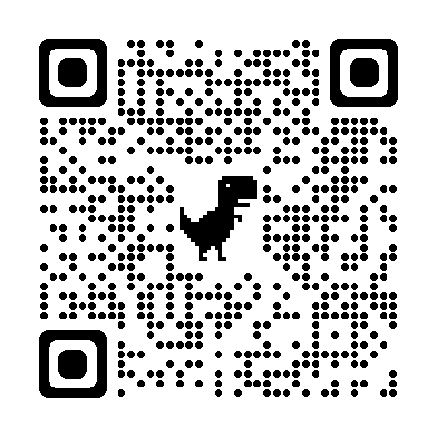
Domestic species compete with wild mammals for Earth’s resources
Source: Research published in The Proceedings of the National Academy of Sciences
Scan for article →

