Slide 1
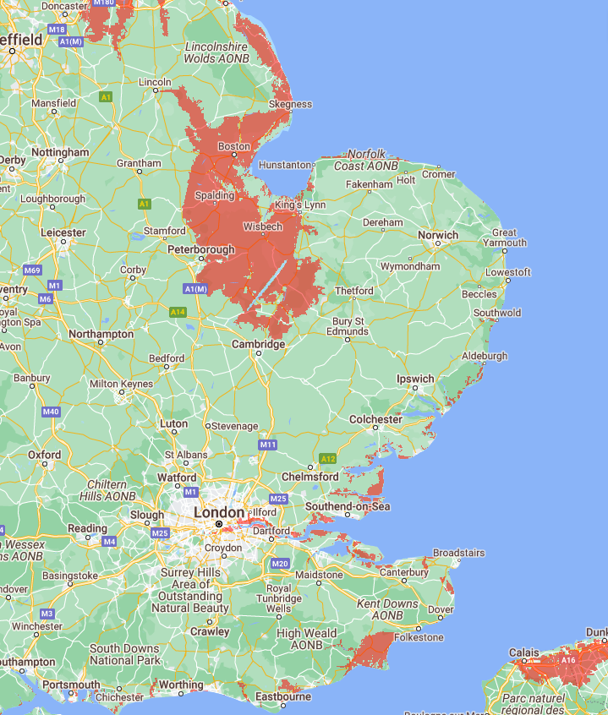
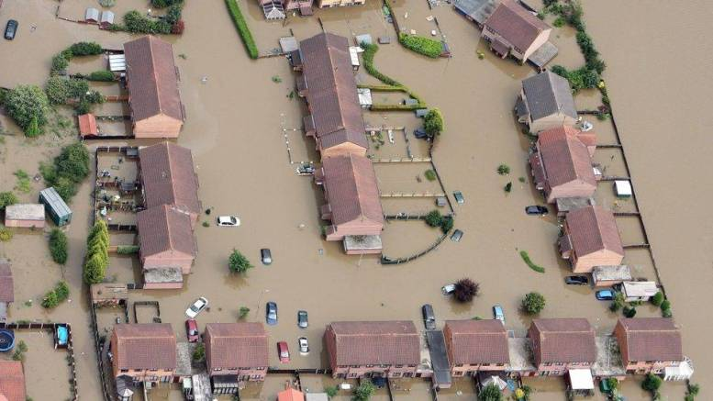
Parts of the UK under water by 2050
NASA predicts sea level to rise up to a foot by 2050
Water level of 1.0 feet above the high tide line could be reached through combinations of sea level rise, tides, and storm surge. Areas will face a choice either will need to be abandoned or upgrade their defences.
©Hull City Council
Below water level with just 30 cm (1 foot) sea rise
Almost half of London’s commercial buildings are at risk from floods fueled by the climate crisis
Scan for more info
Maps from coastal.climatecentral.org
Notes:
Sea Level to Rise up to a Foot by 2050
https://www.nasa.gov/feature/jpl/sea-level-to-rise-up-to-a-foot-by-2050-interagency-report-finds
Maps from https://coastal.climatecentral.org/
Feb 2022 - University of Cambridge research -
First concrete evidence of an ice-sheet mass-loss mechanism, which is not yet included in projections of global sea level rise
https://phys.org/news/2022-02-greenland-ice-sheet-world-largest.html
https://www.edie.net/news/9/Almost-half-of-London-s-commercial-properties-exposed-to-higher-flood-risks/

