Slide 1
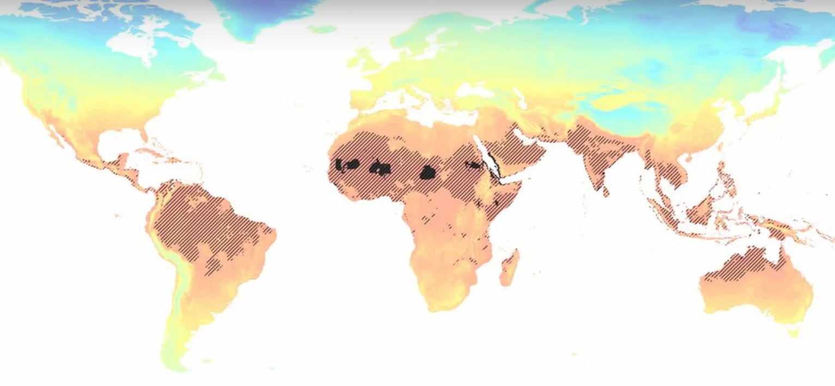
1 billion people displaced for every additional 1°C of global warming
Today
0.8% of land surface too hot for human existence
3°C
19% of land surface too hot for human existence
Source: international research collaboration published in The Proceedings of the National Academy of Sciences
← Scan for article

