Slide 1
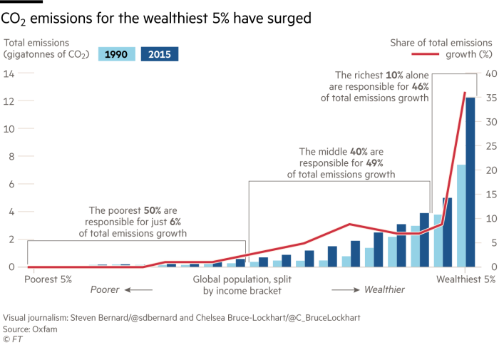
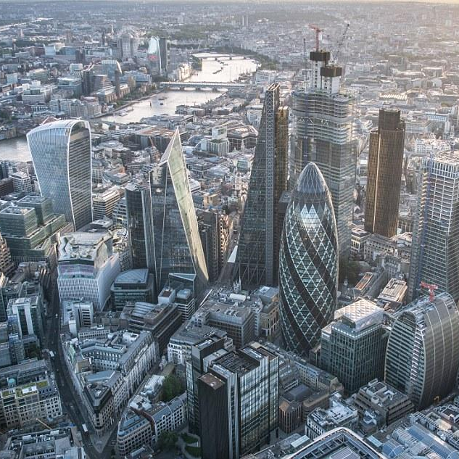
Consumption of richest 10% accounts for almost half of CO₂ emissions
Who are the rich?
Richest 10%
Annual income of £27,500
Richest 1%
Annual income of £79,000
Source: Oxfam/Stockholm Environment Institute
Scan for more info
The City of London remains one of the largest global centres for financing fossil fuels, supporting at minimum 15% of potential global CO₂ emissions
Source: Carbon Tracker 2020
← Scan for report

