Slide 1
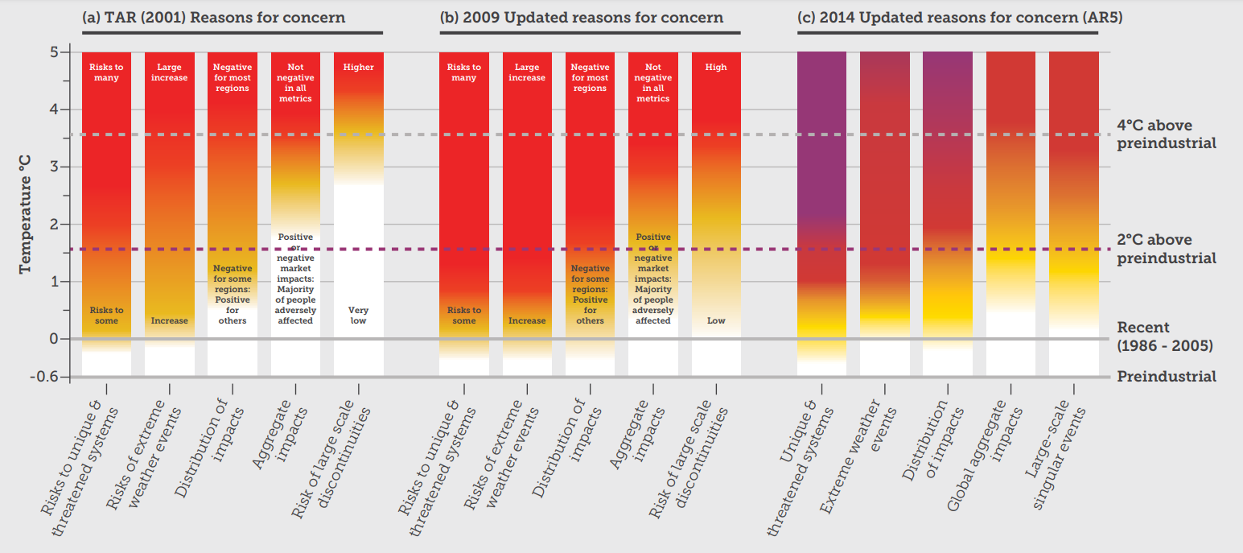
Overall risks and impacts turn to high, faster than anticipated
Scan for more info
Unique and threatened systems | Risks to ecological and human systems, such as coral reefs, the Arctic and its Indigenous People, mountain glaciers and biodiversity hotspots.
Extreme weather events | Impacts to human health, livelihoods, assets and ecosystems from extreme weather events such as heatwaves, heavy rain, drought and associated wildfires, and coastal flooding.
Distribution of impacts | Aggregated risks/impacts that disproportionately affect particular groups, such as vulnerable societies and socio-ecological systems, including disadvantaged people and communities in countries at all levels of development, due to uneven distribution of physical climate change hazards, exposure or vulnerability.
Global aggregate impacts | Impacts to socio-ecological systems that can be aggregated globally into a single metric, such as monetary damages, lives affected, species lost or ecosystem degradation at a global scale.
Large-scale singular events | Relatively large, abrupt and sometimes irreversible changes in systems caused by global warming, such as ice sheet disintegration or thermohaline circulation slowing and sometimes called tipping points or critical thresholds.
Notes:
a904b54ce67740c4b4ee2753134154b0.pdf

