Slide 1
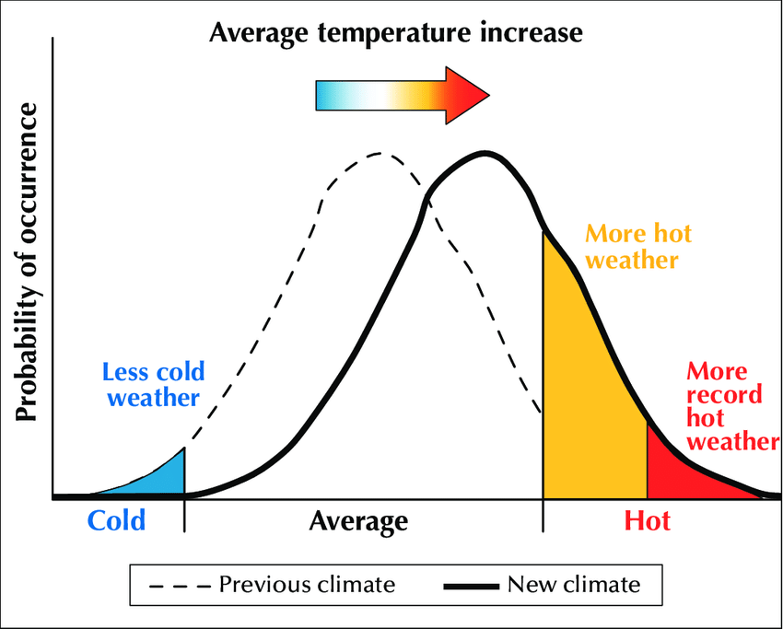
Higher average temperatures make extreme hot weather more likely
Heat waves pose a major risk to public health
“In an average year in the US, heat kills more people than any other type of extreme weather” Kristina Dahl, Senior Climate Scientist
Scan for explanation of models

