Slide 1
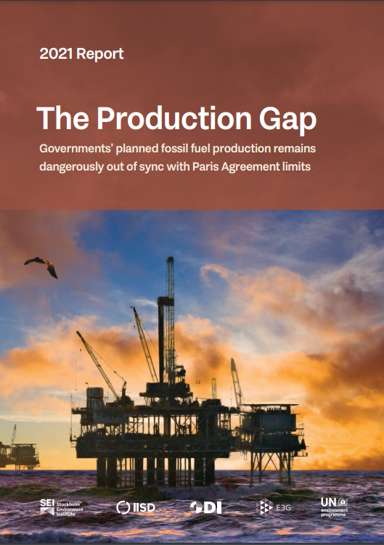
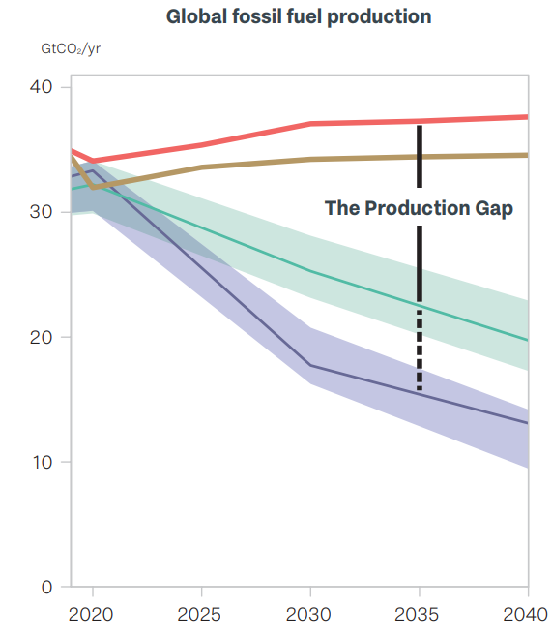
Production exceeds promised reduction
Countries’ plans & projections
Production implied by climate pledges
Production consistent with 2°C
Gigatonnes of CO₂ per year
Production consistent with 1.5°C
1 Gigatonne = 1,000,000,000 tonnes
Year
Scan for more info

