Slide 1
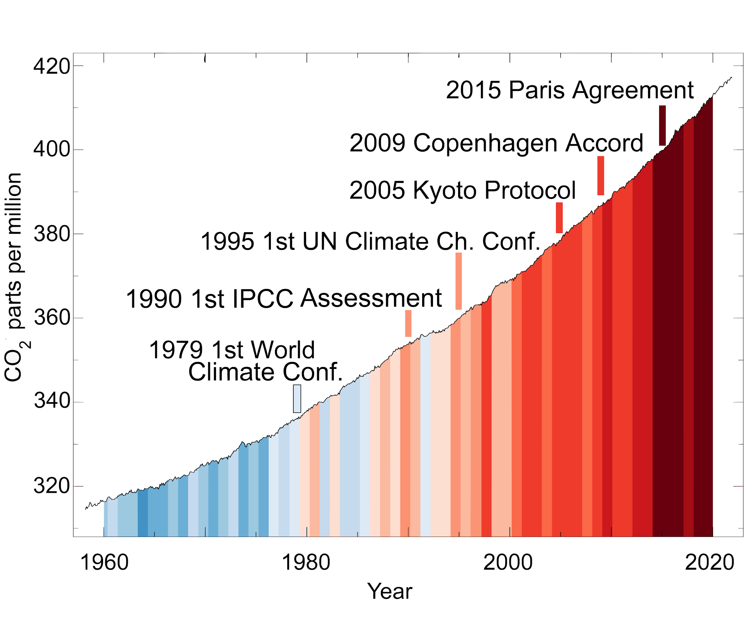
From Wikimedia Commons
Attribution/reference:
@MuellerTadzio, @wiebkemarie, @MariusHasenheit, @sustentioEU
CO₂ and global temperatures rise despite promises

